Slide 1


.
CONVEX PROJECT
STUDENT SCORE EXAM OPTIMIZATION
PAGE
01

Slide 2

Our Team Member
Ziad Adel Farghaly
Ziad Tarek Galal
Ziad Waleed Mohamed
Ziad Atef Ali
Ziad Hesham Ezz El-Din
Abdul-Fattah Abdullah
Rawan Hesham Mostafa
PAGE
02

Slide 3



STUDENT EXAM SCORE
The project focuses on analyzing and optimizing student exam scores to create a fair and balanced grade distribution. By studying the score distribution, we aim to minimize grade disparities while adhering to constraints like minimum and maximum grades. Convexity is analyzed to ensure the fairness of the objective function. Non-convexity is introduced by modifying the data, and optimization techniques are applied to restore a convex, equitable distribution. This process is crucial in educational systems to address grading inconsistencies, promote fairness, and ensure grades reflect actual performance. The outcome helps in improving assessment methods and supporting data-driven educational reforms.
PAGE
03

Slide 4

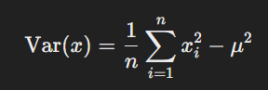
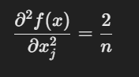
BRIEF OF EQUATION AND CONSTRAINT
The term of sum is a quadratic function, which is convex because its Hessian matrix (identity matrix scaled by a constant) is positive semidefinite
the Score Constraint is Range
X>=0
X<=100
PAGE
04

Slide 5
REAL DATASET
( STUDENT PERFORMANCE IN EXAM )
https://www.kaggle.com/datasets/spscientist/students-performance-in-exams
Link Of DataSet
the Dataset Shows Test Score for three Suject For 1000 Student about (Math - Reading - Writing)
PAGE
05

Slide 6

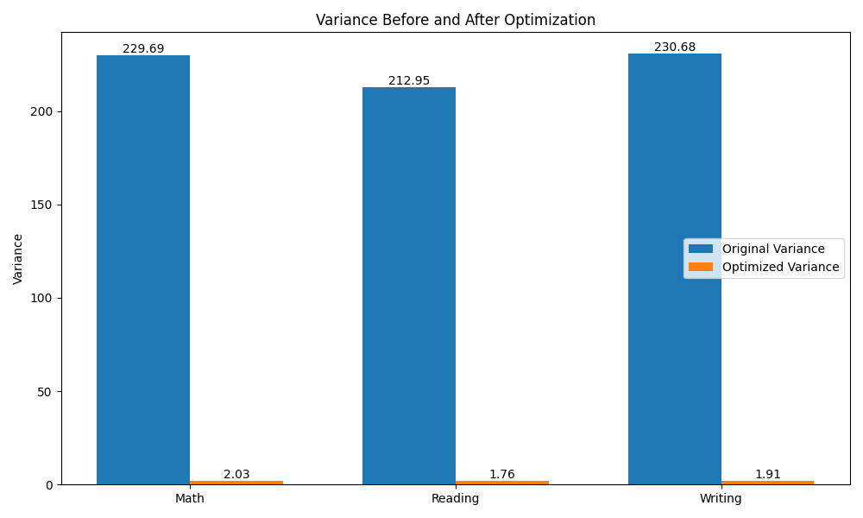
6AGE
06

Slide 7
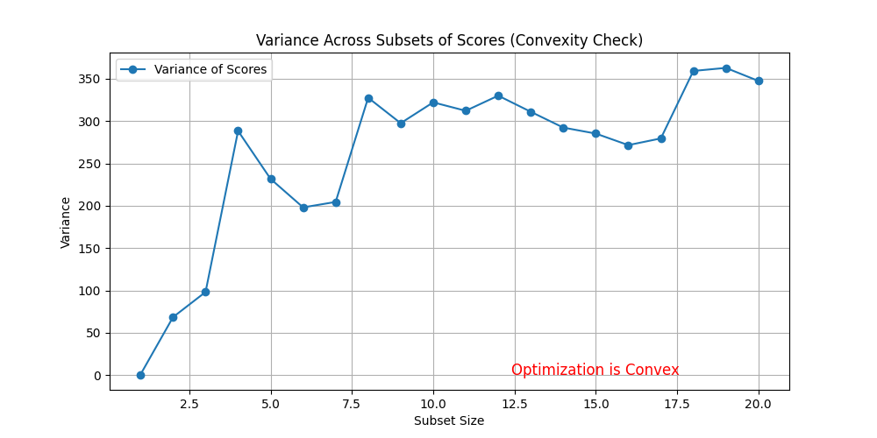
6AGE
07

Slide 8
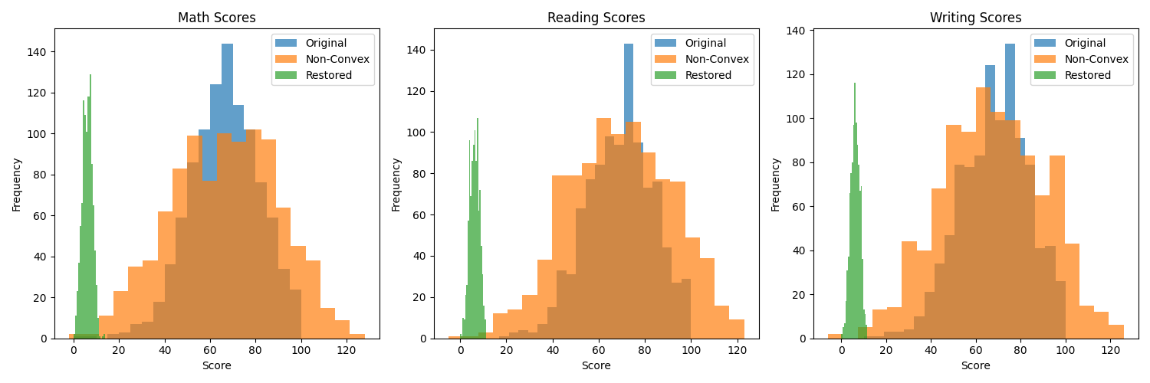
6AGE
08

Slide 9
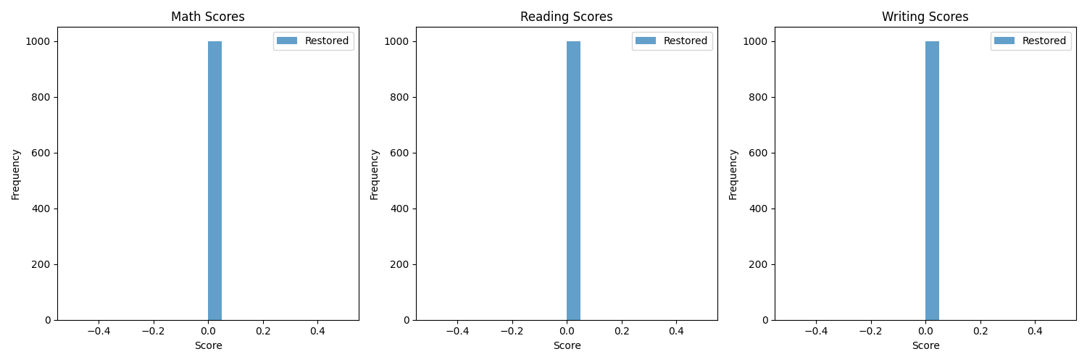
When Global Minimum
6AGE
09

Slide 10
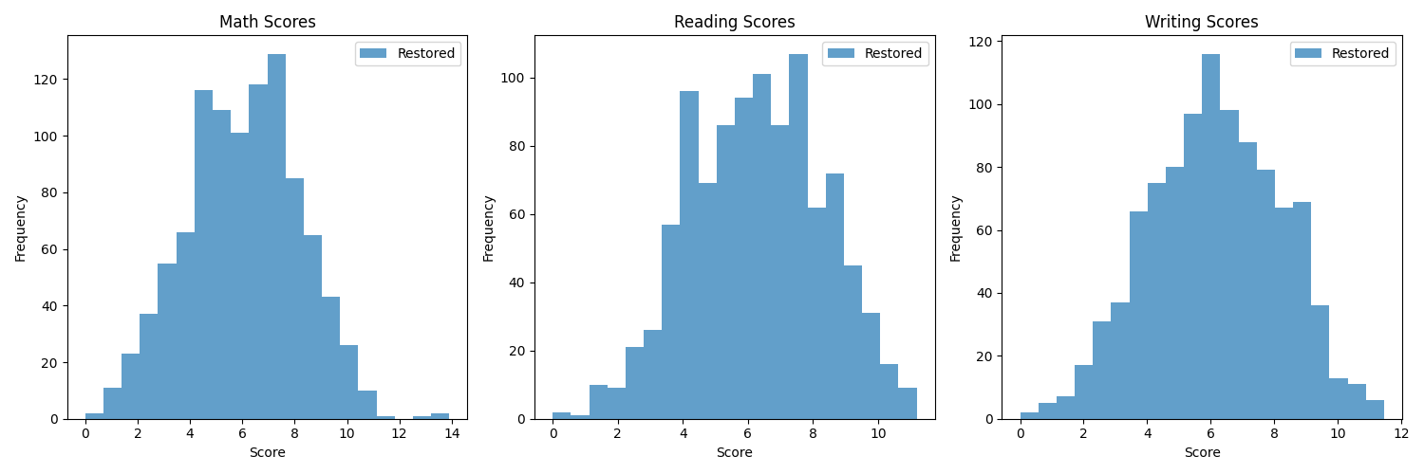
When Alpha near to original Score
6AGE
10

Slide 11
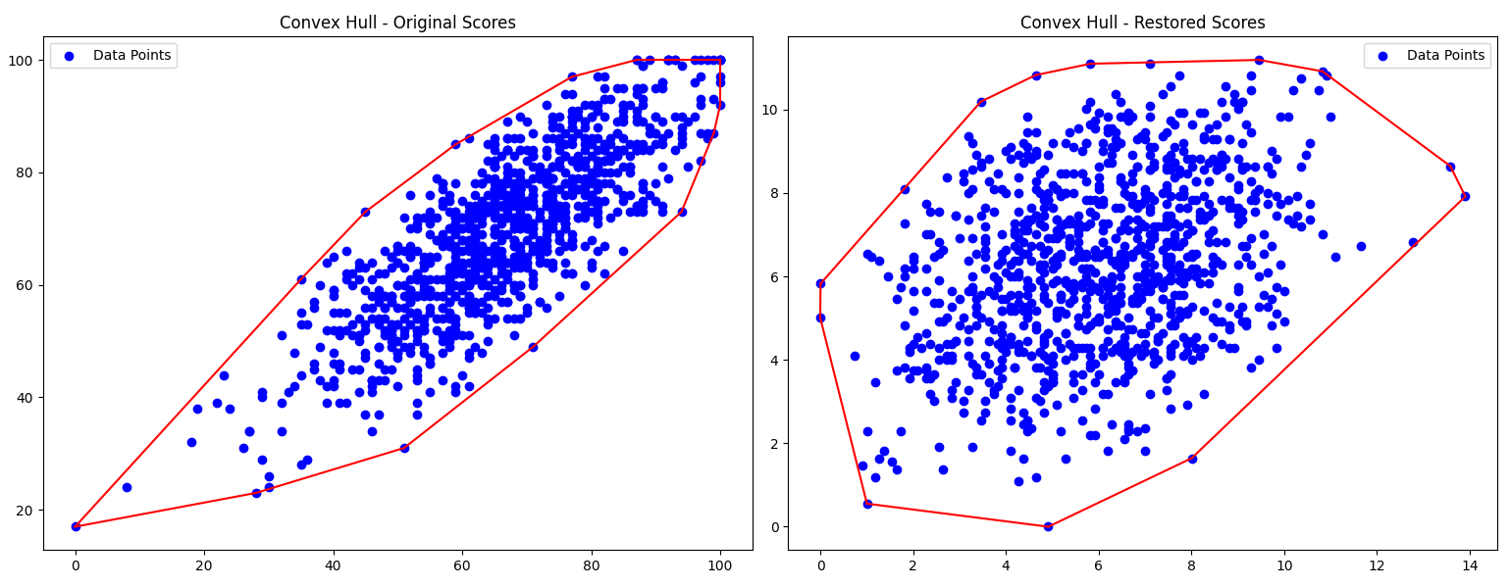
Convex Hull For all 2 Level (MATH-Reading)
6AGE
11

Slide 12

RESULTS
In this project, we analyzed student exam scores with the goal of minimizing variance to promote fairness in grade distribution. Initially, we confirmed the convexity of the score distribution using the variance equation, verified mathematically and visually.
The original dataset's distribution was visualized, showing a balanced spread. To introduce non-convexity, we added outliers, disrupting the constraints and creating an irregular distribution, as depicted in Figure 3, and restored datasets.
6AGE
12

Slide 13
STEPS
Optimze BY CVXPY
Violate Constraints
BY Outler
Restored By Checking Constraints
6AGE
13

Slide 14

Finally, we restored convexity by removing outliers and reintroducing constraints, achieving a more organized distribution. The optimization process minimized variance, reaching a global minimum of Variance = 0, and the results were effectively demonstrated through comparative visualizations of the original, mod
6AGE
14

Slide 15

THANK YOU!
PAGE
15

